Slide 1
Lesson 3: public repositories for data mining of functional genomics data
Matteo Dugo, PhD
IRCCS Ospedale San Raffaele
Department of Medical Oncology – Breast Cancer Unit
Clinical translational and immunotherapy research

Slide 2
Gene expression repositories
Repositiories for gene expression data
Include microarray and RNA-Seq
Primarily developed for data storage
Curated or un-curated
Access to data at different levels:
Dataset
Sample
Gene
Integrated databases
Contain gene expression data and additional data of the samples
Array data tends to be more annotated
More analytical tools
Smaller (more QC and curation needed)
Often no direct data access

Slide 3
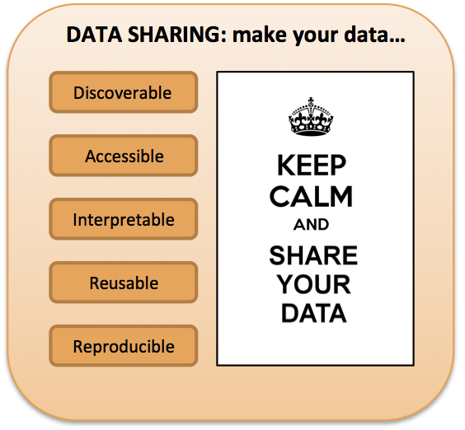
Gene expression repositories
Why do they exist
Transparency and reproducibility of publications
Journals require data to be available for analysis
Nowadays raw data is required
Databases offer single resource and standardized access
Data was generated for a specific purpose, but is not limited to that purpose
Can be reanalyzed in a different context
Can be combined with other datasets
Can be used as independent validation

Slide 4
Gene expression repositories
Where does the data come from?
Expression profiles of
Patients
Model systems
Cell cultures
Data used for publication
Most journals now require at least raw data submission
Very coarse quality control (peer review)
QC depends mostly on authors
Datasets submitted without publication
Little or no QC
Most datasets are tailored towards a specific question

Slide 5
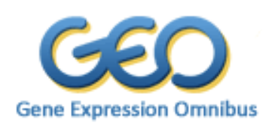

Gene expression repositories
Two main gene expression repositories
NCBI Gene Expression Omnibus (GEO)
https://www.ncbi.nlm.nih.gov/geo/
EMBL-EBI ArrayExpress
https://www.ebi.ac.uk/arrayexpress/

Slide 6
Gene expression repositories
GEO and ArrayExpress are international public repositories that archives and freely distributes microarray, next-generation sequencing, and other forms of high-throughput functional genomics data submitted by the research community.
Three main goals:
Provide a robust, versatile database in which to efficiently store high-throughput functional genomic data;
Offer simple submission procedures and formats that support complete and well-annotated data deposits from the research community;
Provide user-friendly mechanisms that allow users to query, locate, review and download studies and gene expression profiles of interest

Slide 7
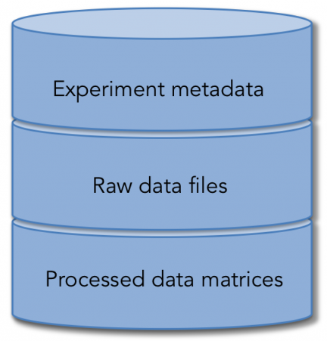
Gene expression repositories
What kind of data are shared?
The repeatability of published studies implies not only making raw data available, but also providing detailed information and protocols about the overall study and individual samples (known as metadata).
Information about biological specimen and experimental procedures

Slide 8
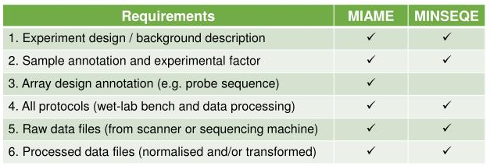
Gene expression repositories
Minimum Information About a Microarray Experiment (MIAME)
Minimum INformation about a SEQuencing Experiment (MINSEQE)
The checklist:

Slide 9
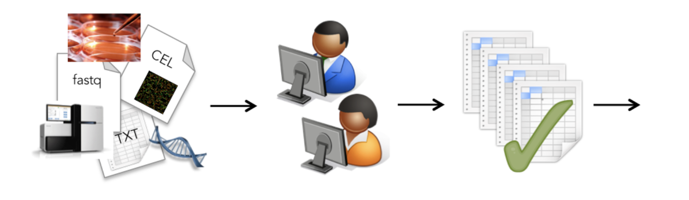
Gene expression repositories
The submission process
Data submission
Curators clean and fix
Standardized file formats
Archiving

Slide 10
File formats
GEO data records:
Platform (GPL): information about the technology used and the features detected
Sample (GSM): preparation and description of the sample
Series (GSE): information about the overall study. Defines a set of samples and how they are related to the data
DataSets (GDS): sample data collections curated and assembled by GEO staff.
ArrayExpress data records:
Array Design Format (ADF): describes the design of an array, i. e. the sequence located at each feature on the array and annotation of the sequences.
Sample and Data Relationship Format (SDRF): contains the relationships between samples and arrays, as well as sample properties and experimental factors, as provided by the data submitter.
Investigation Description Format (IDF): contains top-level information about the experiment including title, description, submitter contact details and protocols.

Slide 11
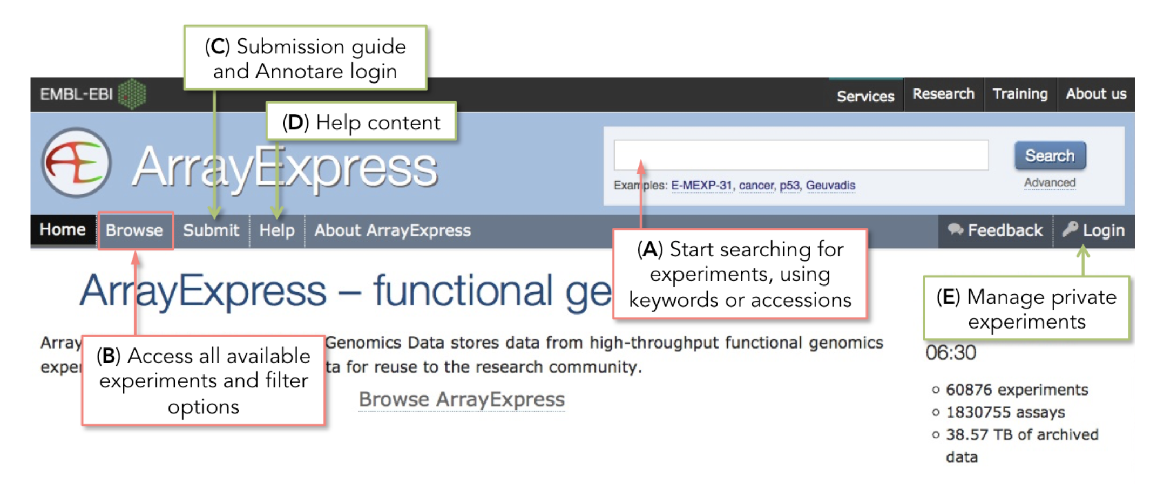
How to search for public data: ArraExpress
The ArrayExpress home page

Slide 12
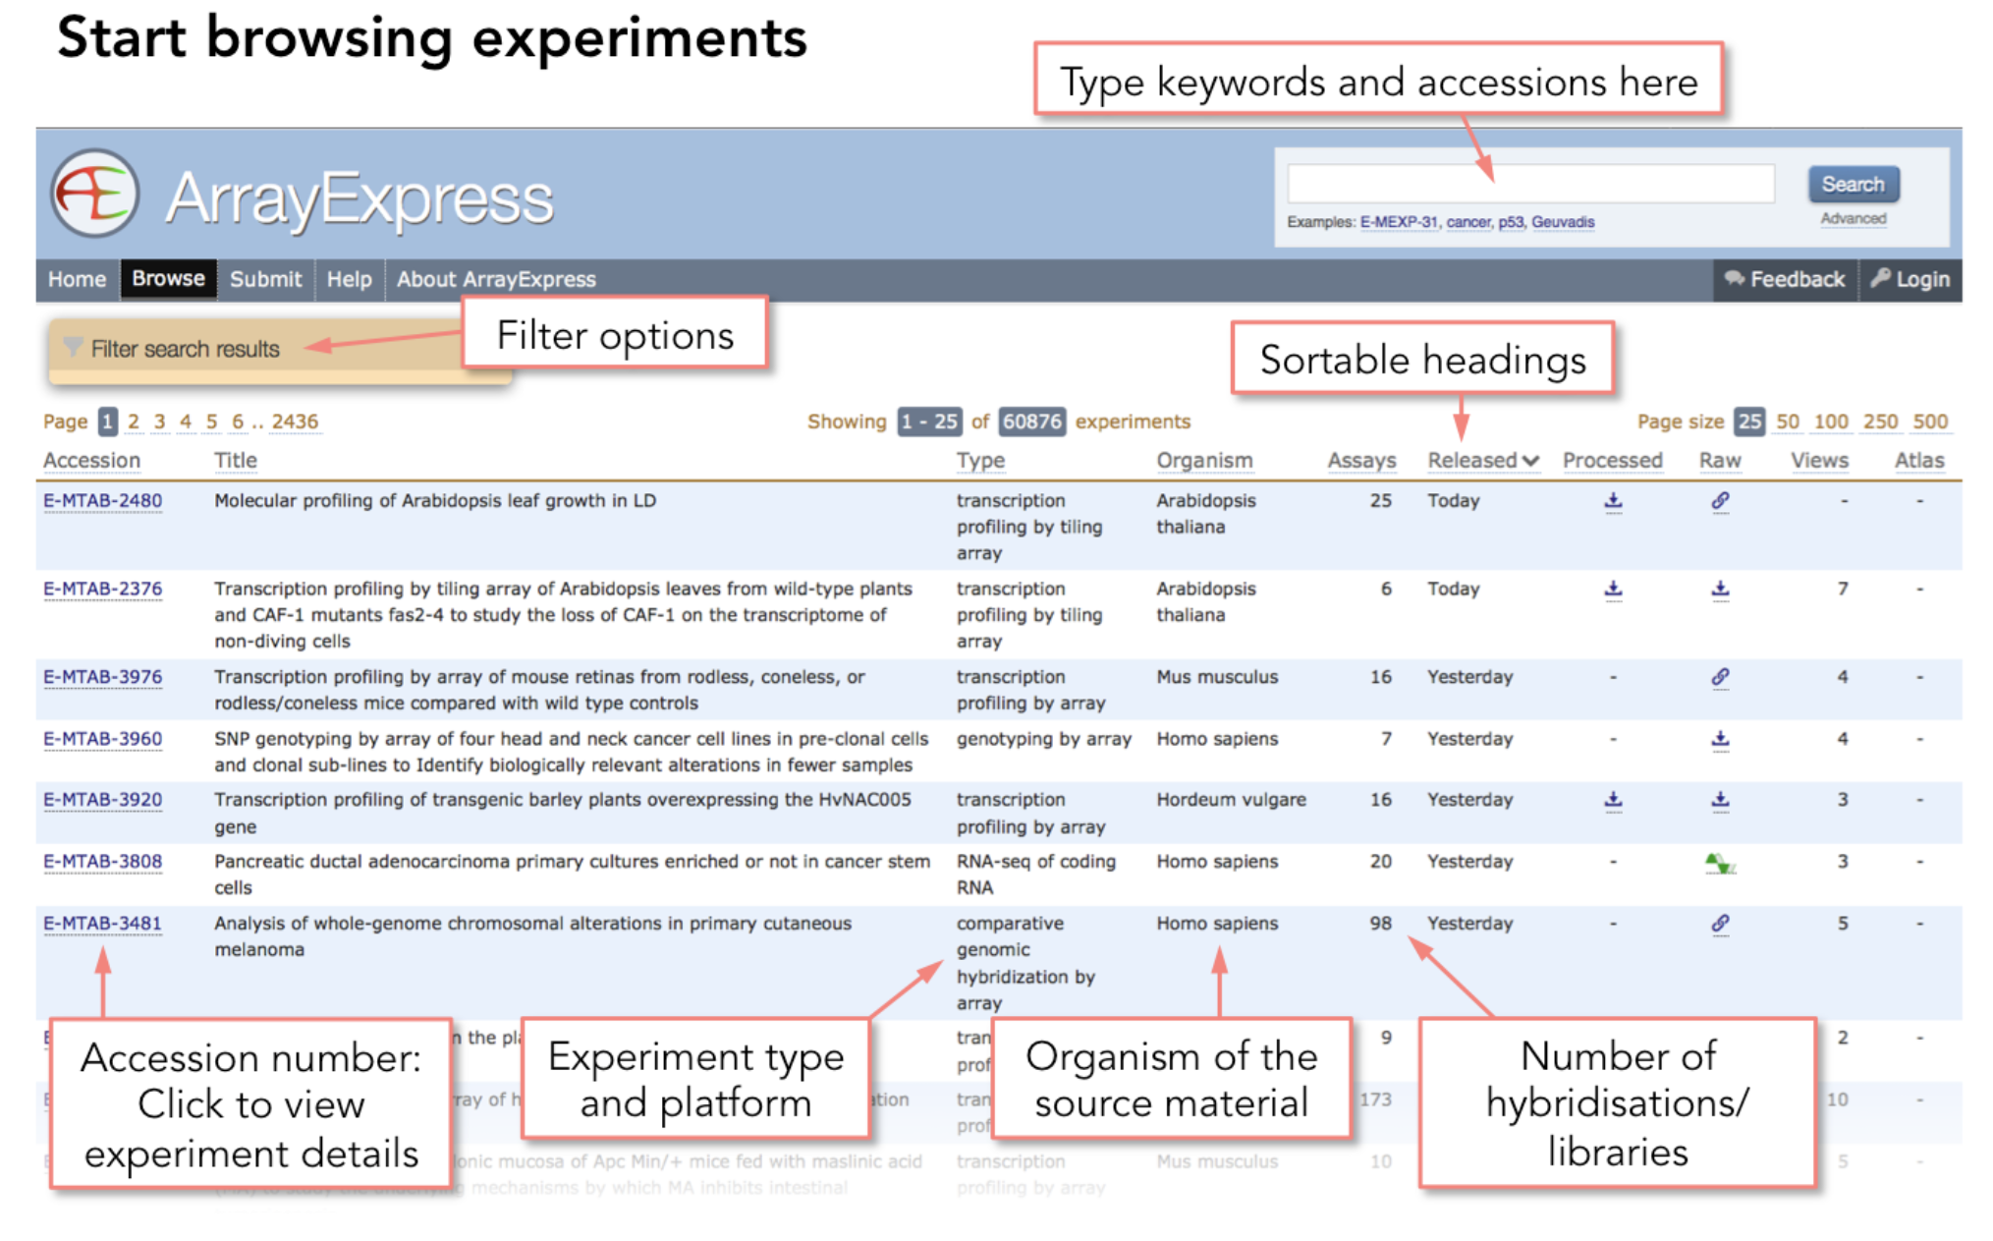
How to search for public data: ArraExpress
Search results page

Slide 13
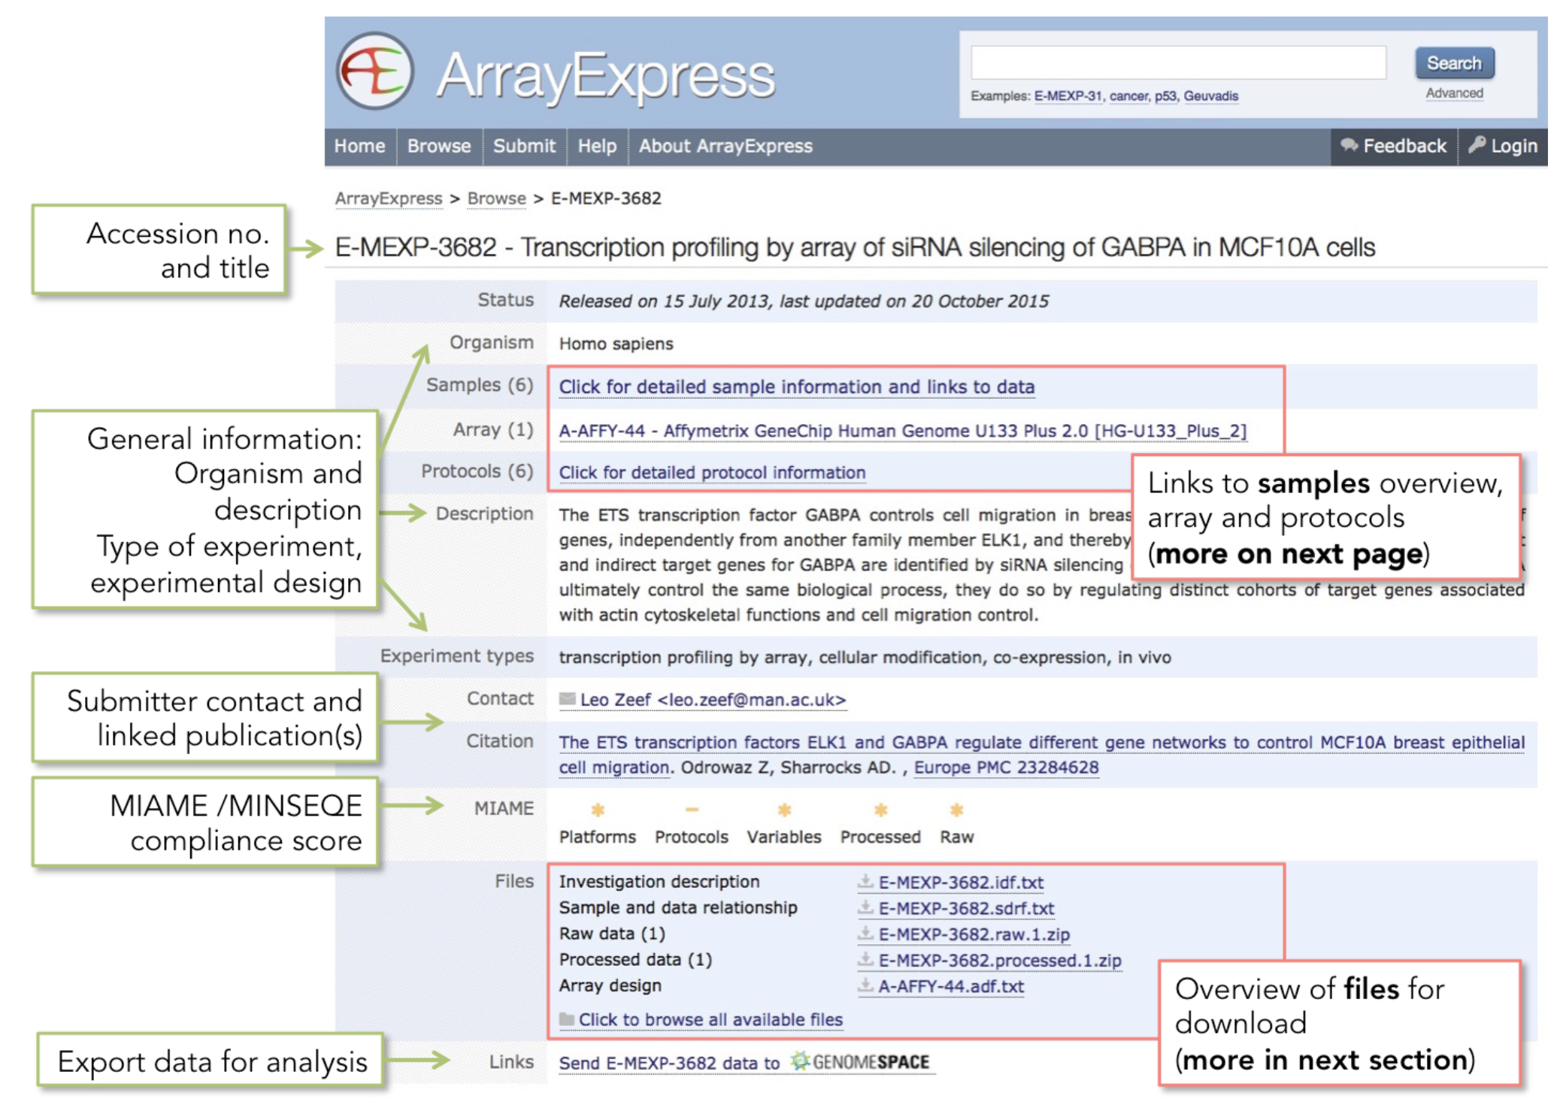
How to search for public data: ArraExpress
The experiment page

Slide 14
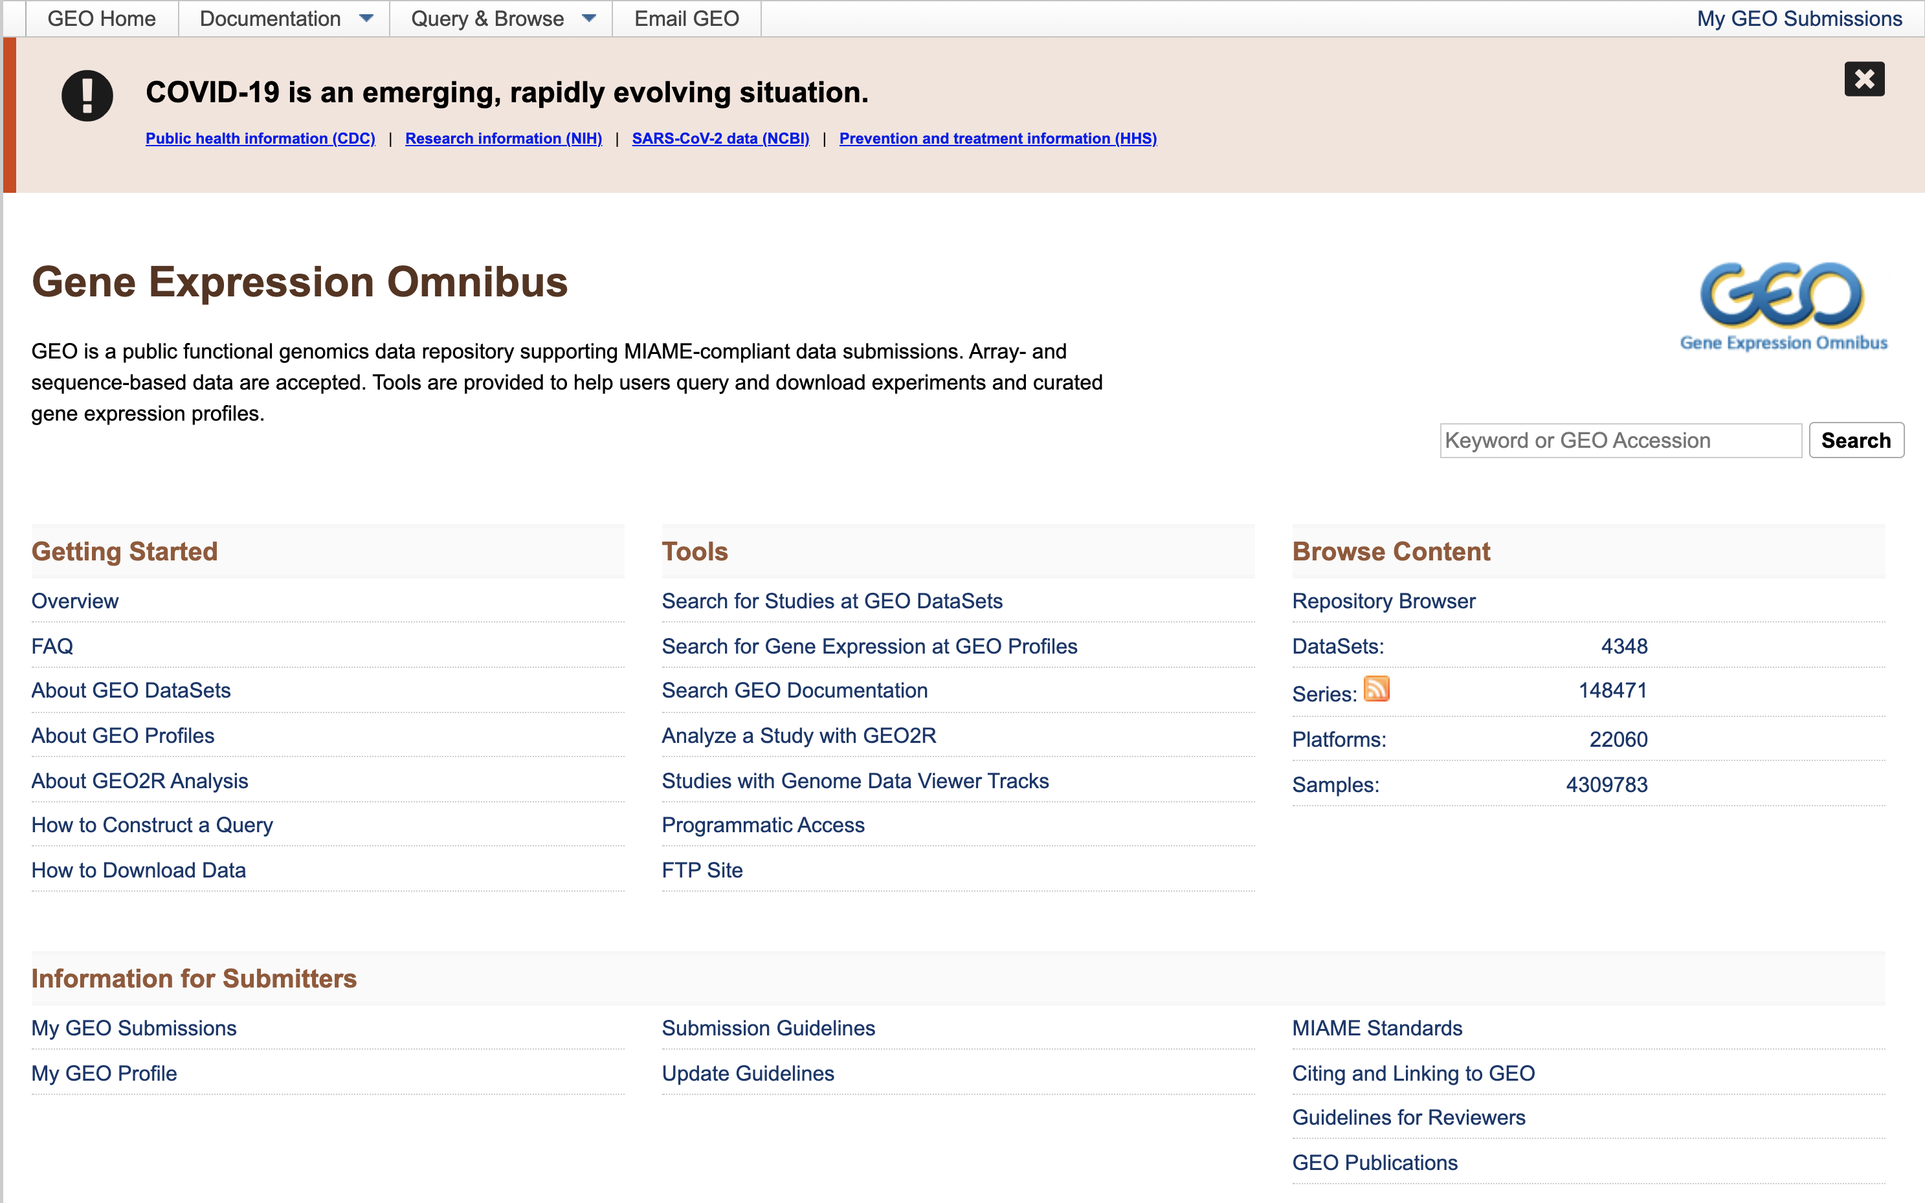
How to search for public data: GEO
The GEO home page
Search for keyword or accession number
Documentation
Content navigation
Submission guidelines

Slide 15
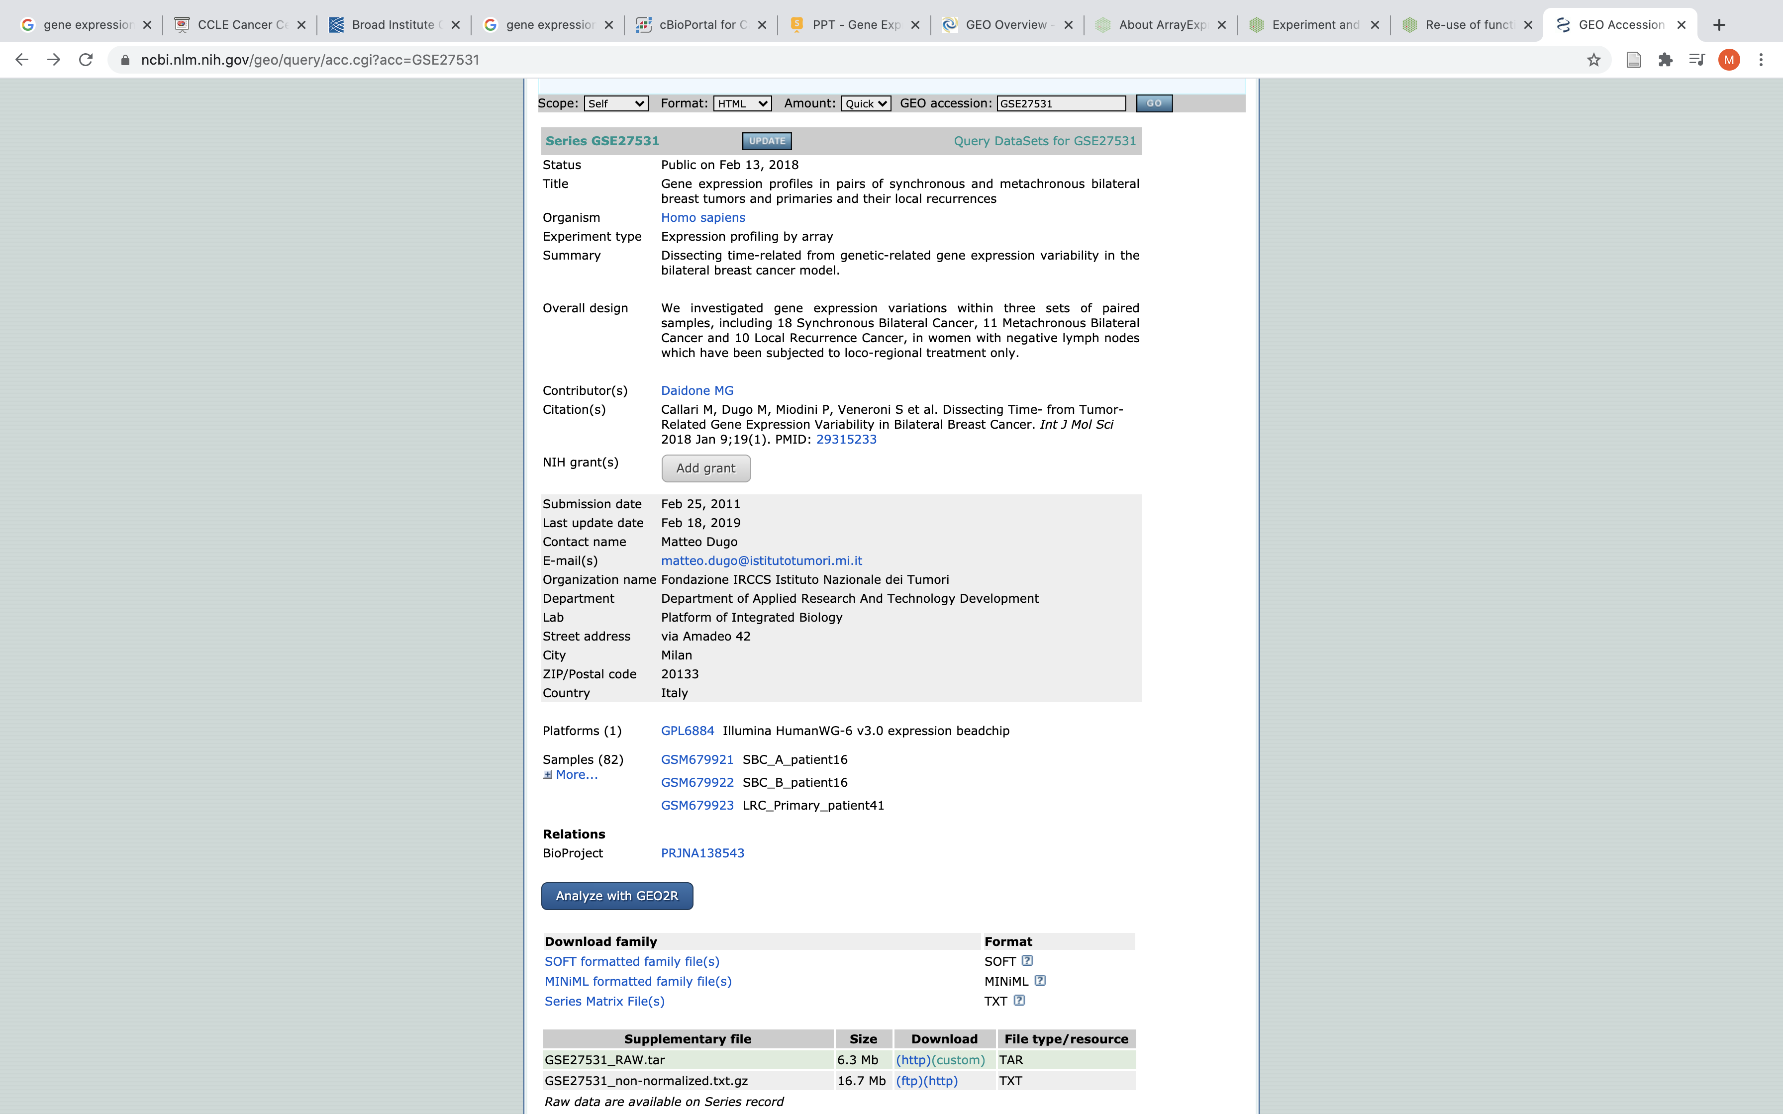
How to search for public data: GEO
The experiment page
Experiment information
Contact information
Platform
Interactive analysis
Samples
Normalized data
Raw data

Slide 16
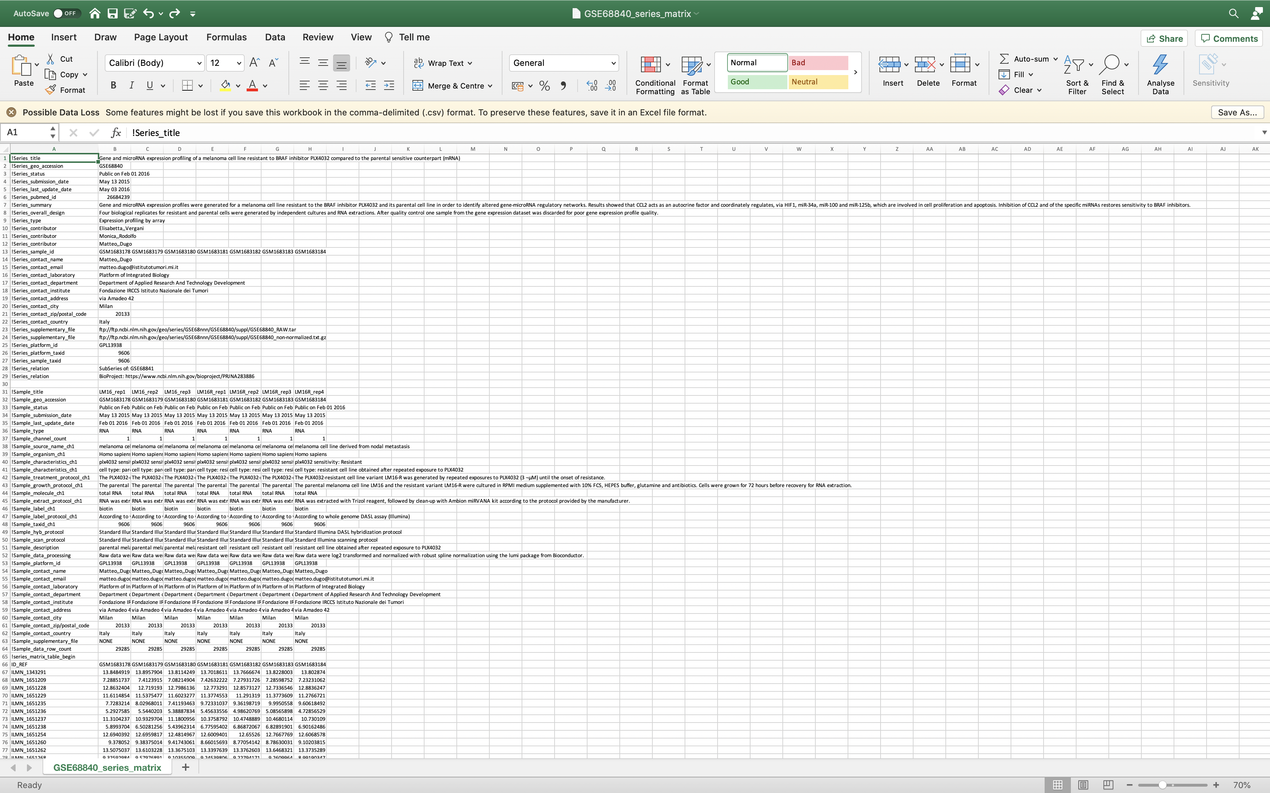
How to search for public data: GEO
Normalized data are available in the Series Matrix file.
Text file that contains all information present in the experiment page
Experiment information
Sample information
Normalized gene expression data

Slide 17
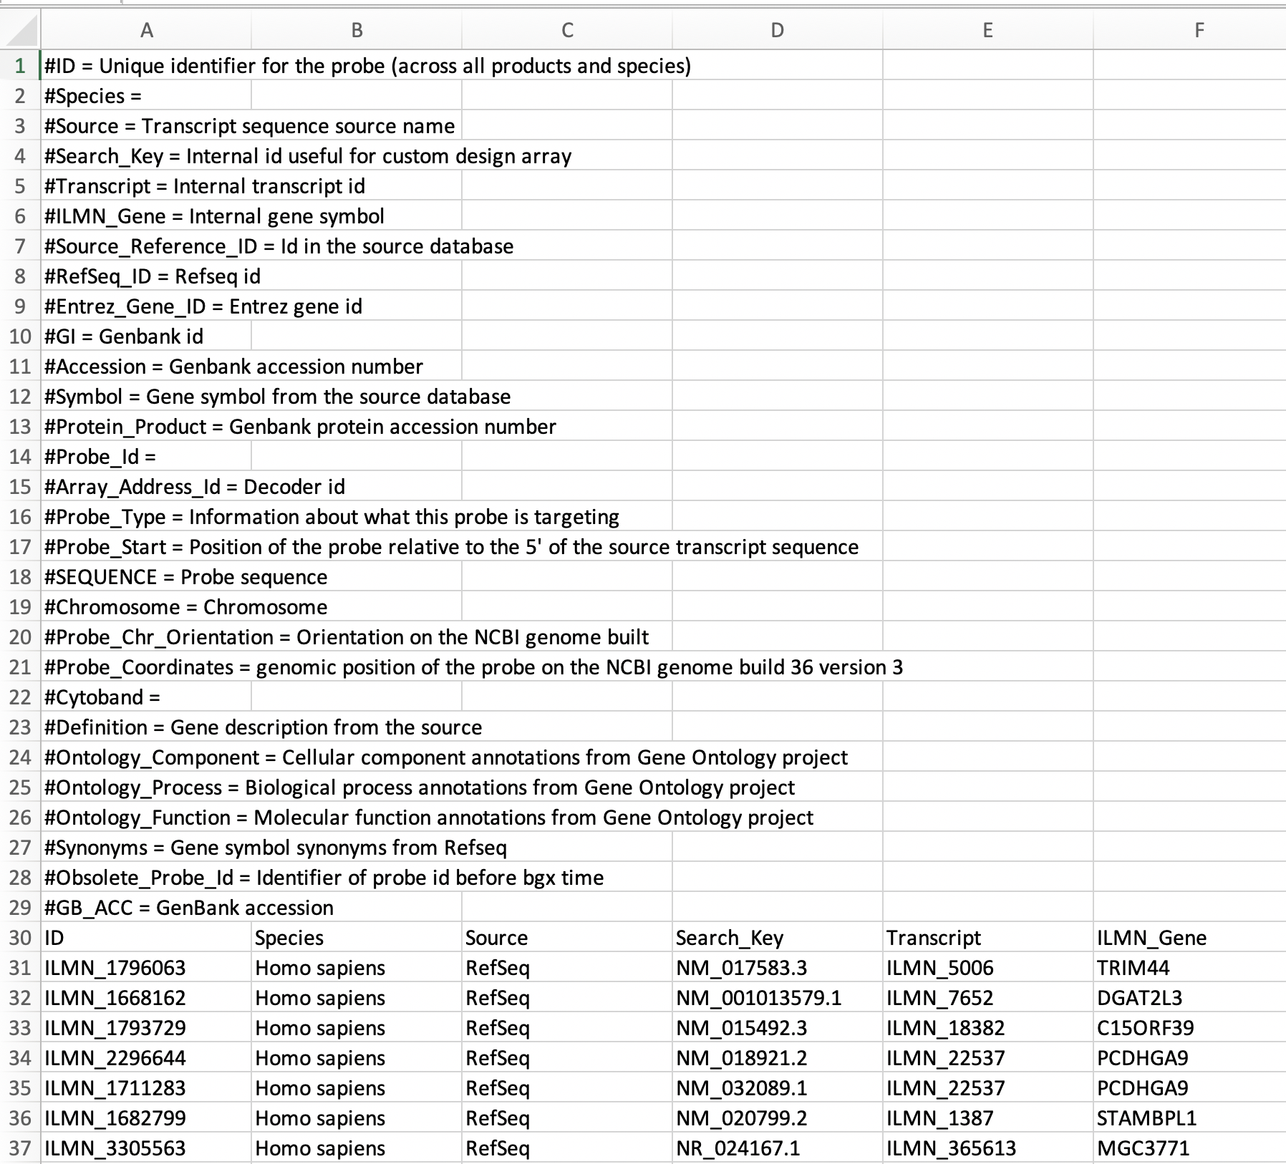
How to search for public data: GEO
Genes in the series matrix are identified by the gene IDs of the used platform (in this case are illumina probe id).
Annotation to gene symbol is retrieved from the platform annotation file (the GPL file downloadable from the experiment page)
Columns description
ID in the series matrix file
Platform ID annotation

Slide 18
Analyzing public data from GEO
What is GEO2R?
Interactive web tool that allows users to compare two or more groups of samples in a GEO series to identify genes that are differentially expressed across experimental conditions
Simple interface that allows users to perform R statistical analysis without command line expertise

Slide 19
Analyzing public data from GEO
How to use GEO2R?
1-Identify the dataset of interest
Follow a link from a Series record OR
Enter a Series accession number
2-Define Sample groups
At least 2, up to 10 groups can be defined
3-Assign Samples to each group
Not all samples in a series need to be selected
4-Run the analysis
Assess sample value distributions for QC
If necessary edit default parameters
5-Interpret the results

Slide 20
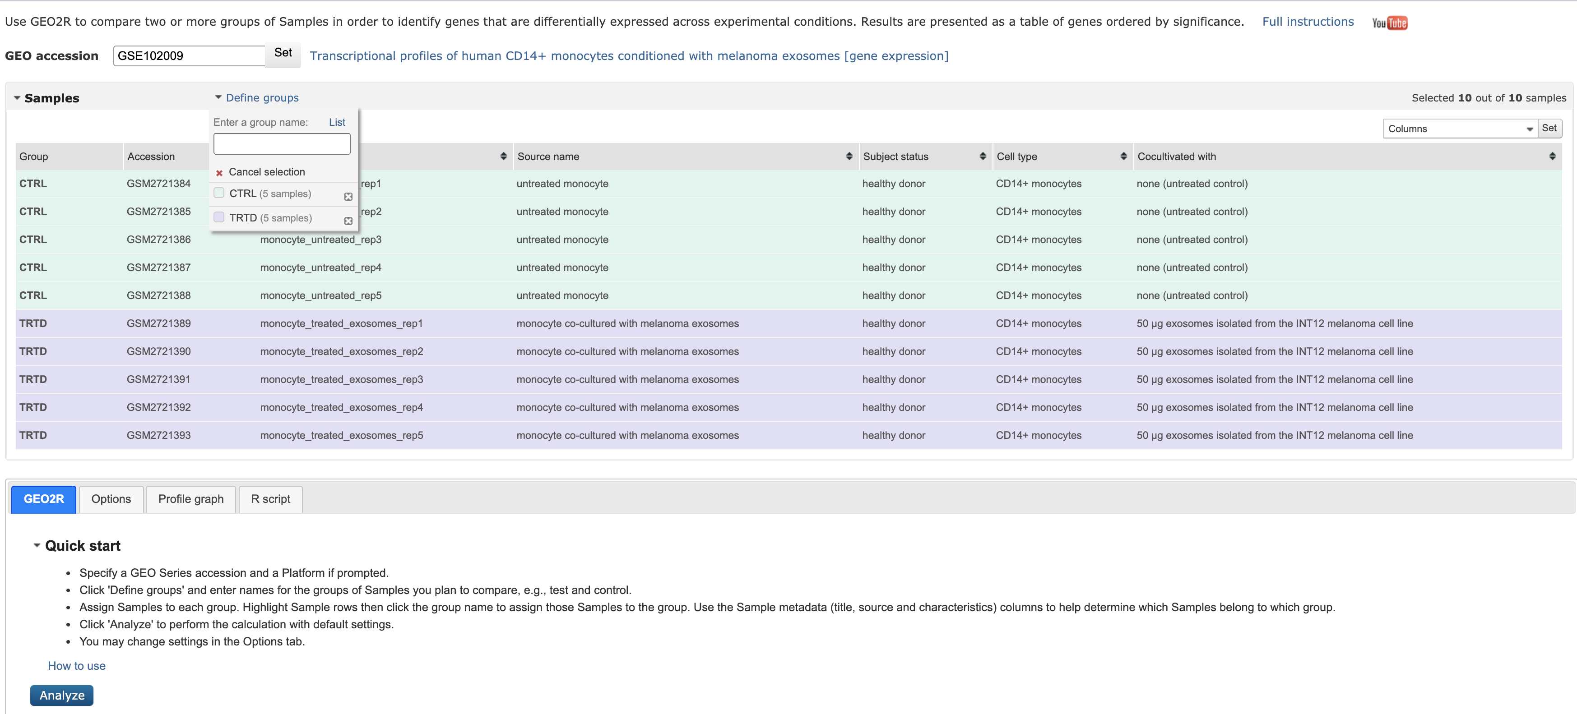
Analyzing public data from GEO
1-Identify the dataset of interest
2-Define Sample groups
3-Assign Samples to each group
4-Run the analysis

Slide 21
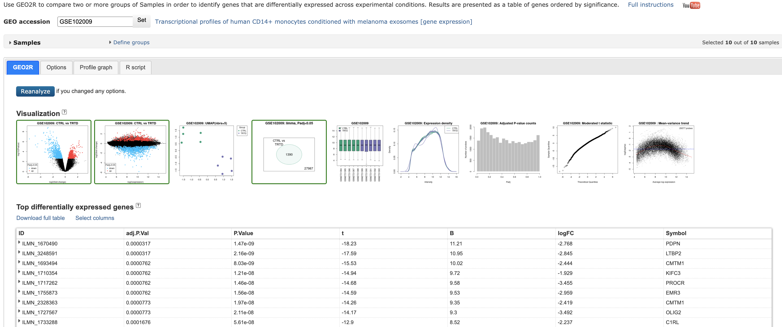
Analyzing public data from GEO
5-Interpret the results

Slide 22
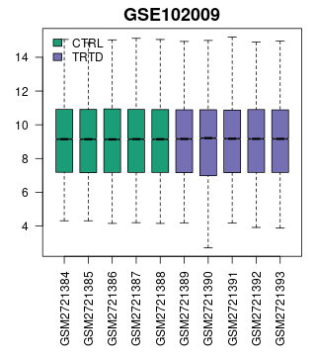
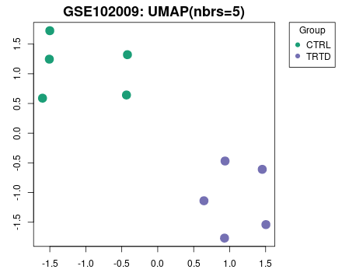
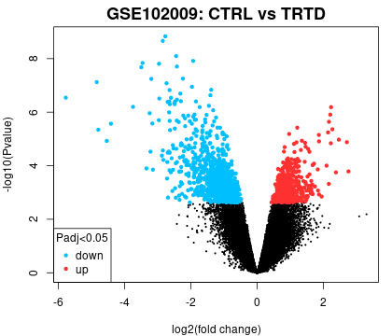
Analyzing public data from GEO
Visualization
Box-plots
Use to view the distribution of the values of the selected samples. Viewing the distribution can be useful for determining if your samples are suitable for differential expression analysis. Generally, median-centered values are indicative that the data are normalized and cross-comparable.
UMAP
Uniform Manifold Approximation and Projection is a dimension reduction technique useful for visualizing how Samples are related to each other.
Volcano plot
A volcano plot displays statistical significance (-log10 P value) versus magnitude of change (log2 fold change) and is useful for visualizing differentially expressed genes.

Slide 23
Other data repositories
GEO and ArrayExpress are mainly used to interrogate published expression data
Multi-omics characterization of tumor specimens + clinical information
The Cancer Genome Atlas (TCGA)
International Cancer Genome Consortium (ICGC)
Multi-omics characterization of human cancer cell lines + drug sensitivity data
The Cancer Cell Line Encyclopedia (CCLE)
The Genomics of Drug Sensitivity in Cancer (GDSC)
HUGE DATASETS!!!
Different web-based tools (cBioPortal, TumorPortal) exist to explore these datasets but not always useful for your biological questions.
Best way to analyze these datasets: ASK FOR HELP TO A BIOINFORMATICIAN!

Slide 24
Exercise
Search for GSE68840 in GEO
Perform class comparison between Resistant and Parental cell lines using GEO2R and download the differential expression table (remember to add the gene symbol column to the table). Attention to the direction of the comparison: GEO2R compares the first created group vs the second.
Download normalized data (the Series Matrix File)
Re-format the file to make it easily analyzable in excel and add annotation from the GPL file (make sure that IDs in the two files are in the same order)
Perform class comparison between Resistant and Parental cell lines using excel as previously done (use the homoscedastic option for excel t-test)
Select genes with a log fold change > 1 and an FDR < 0.05
Compare the lists of differentially expressed genes obtained with the two methods using Venn Diagrams (online venn diagrams can be generated at this link: http://bioinformatics.psb.ugent.be/webtools/Venn/). Use the gene symbol as common gene identifier to compare the two lists.

Slide 25
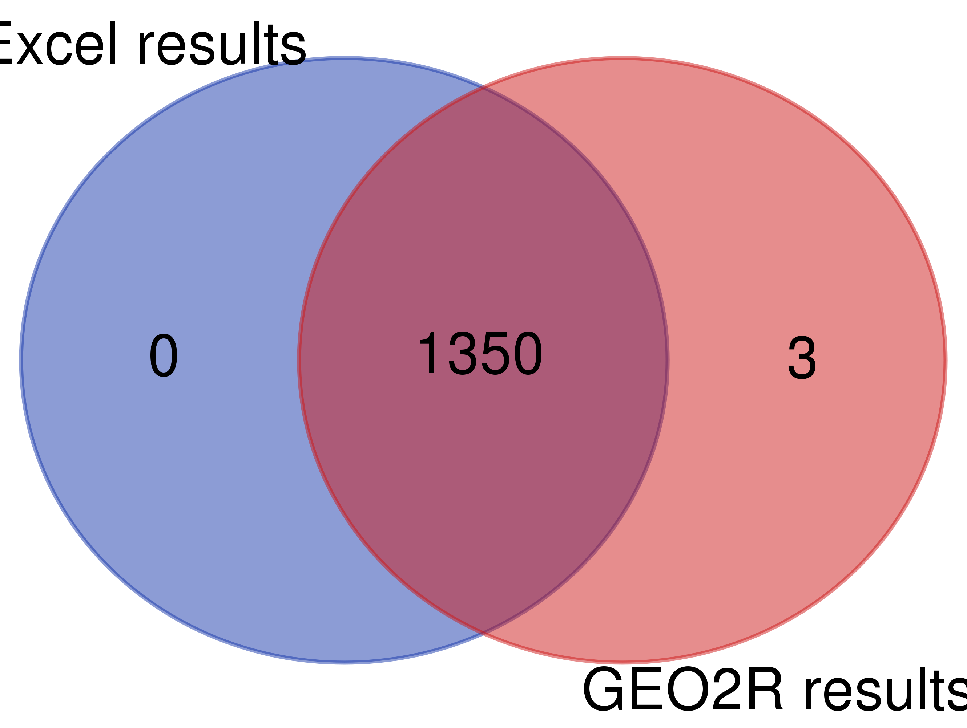
Exercise
Expected result

Slide 26
References and additional material
NCBI GEO documentation
https://www.ncbi.nlm.nih.gov/geo/info/
ArrayExpress tutorials
https://www.ebi.ac.uk/training/online/courses/array-express-discover-functional-genomics-data-quickly-and-easily/
https://www.ebi.ac.uk/training/online/courses/functional-genomics-iii-submitting-data/
TCGA website
https://www.cancer.gov/about-nci/organization/ccg/research/structural-genomics/tcga
TCGA data portal
https://portal.gdc.cancer.gov/
ICGC website
https://dcc.icgc.org/
CCLE Website
https://portals.broadinstitute.org/ccle
GDSC website
https://www.cancerrxgene.org/
cBioPortal for exploratory visualization of large-scale cancer genomics datasets
https://www.cbioportal.org/
TumorPortal for visualization of recurrent genomic alterations in TCGA data
http://www.tumorportal.org/

